Slide 1
Cycle Logistics Accreditation Scheme
Ian Brocklebank
Last Mile
Cycle Delivery in Leeds and Manchester, UK
Member of UKCLF
Notes:
This presentation was delivered as part of wider session focussing on the role of national Cyclelogistics operators at the ECLF (European Cycle Logistics Federation conference in Vienna, March 20th, 2017.

Slide 2
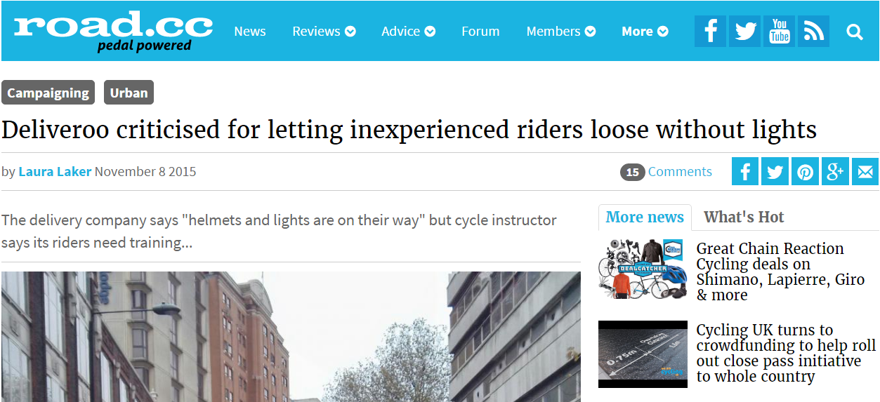
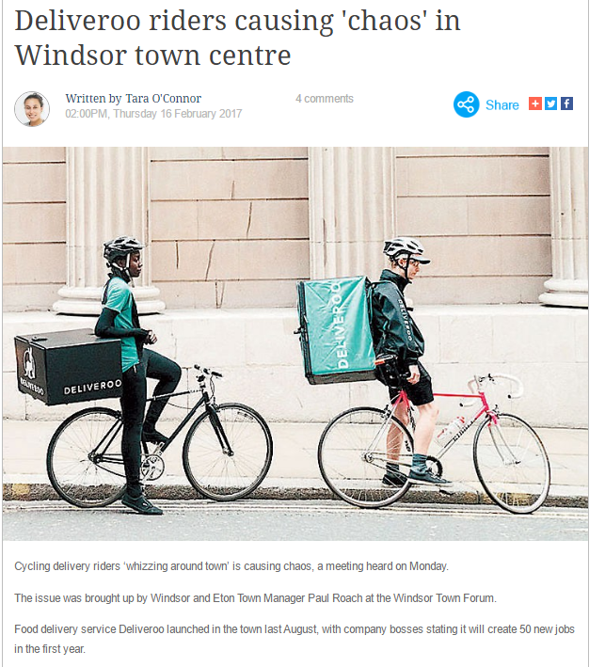
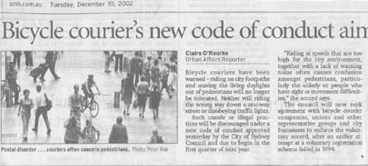
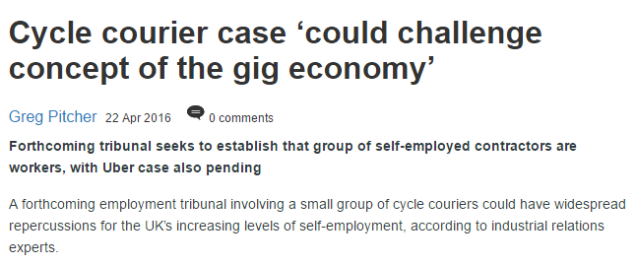
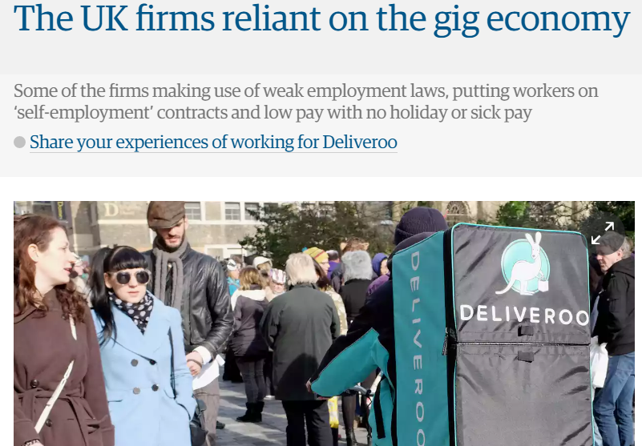
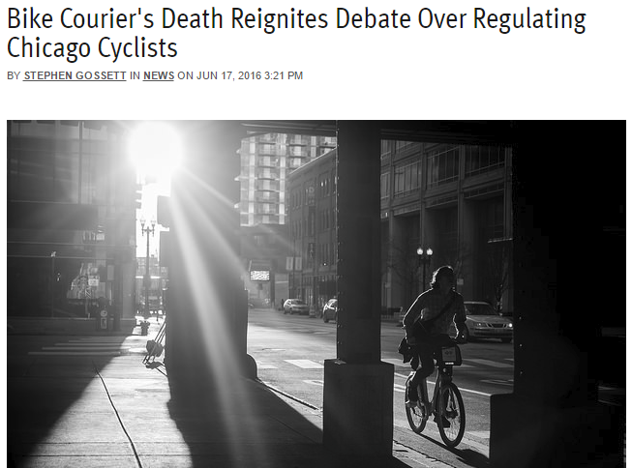
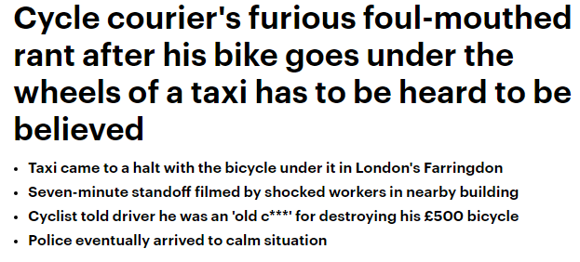
Notes:
Cycle Logistics is in the news. And not always in a good way! We know we have ‘made it’ when we become the focus of one of the most disruptive dot.coms in the past few years but their employment practices, and the behaviour of their ‘non’-staff, does not create the best reputation for cycle delivery. If our industry is to live beyond the current focus on reducing emissions, we have to be about livable cities and creating safer more welcoming spaces for us all to live and work. There have not been very many accidents due to cycle couriers, but perception is everything, and if we are to continue to win the hearts and minds of populations and city authorities we must ensure that we can set ourselves apart from less careful operators. When I am asked about my business it often comes in the form of “Like Deliveroo?”
In addition, as we gather a set of standards we can expect all of us to raise our game, and ensure that we keep each other accountable to achieving those standards.

Slide 3
Risks
Increasing visibility
E-Bikes
Voluntary guidelines or regulations?
Build (and protect) the credibility of the Cyclelogistics Industry
Notes:
So there are a number of risks that our industry faces.
First is our increasing visibility and the need to ensure that our companies can show ourselves not to be cycle cowboys.
Second, is as the number of e-bikes increases, and their size also increases, there is the very real prospect of them being involved in some major accident at some point. A 250kg vehicle travelling at 27km/h, virtually silently is a potential risk to pedestrians particularly. We flourish because we operate on the margins between pedestrian and road transport. What we can’t afford is a knee-jerk reaction to an incident that suddenly restricts the use of cargo-bikes and if we can show that are already observing reasonable safety guidelines then we can demonstrate ‘best practice’.

Slide 4
Assessment Levels
3 levels of assessment
Easy entry
Increasing challenge
Mutual support
Peer assessment
Sharing of experience
Covering all aspects of business
Resistance to disruption
Security
Fleet
HR (Health & Safety; Training)
Df
Notes:
When I submitted this paper, I had hoped that we would have more to show you today, but family illness has meant that my colleague has not been available to develop this fully. Later I will give a web address where we will post details as they become available.
We will have three levels of assessment, gold, silver and bronze, with increasing levels of challenge, and increasing levels of accountability.
The scheme is built on the principle of sharing experience and expertise within our industry, and will cover all aspects of our businesses. First focussing on that which will be important to our customers – large consolidators like DHL or Fedex/TNT but also to local and EU employment regulations and staff welfare. Separately, but in parallel we are also developing a training scheme for cycle couriers, which will encourage all operators to ensure that their staff are adequately trained before being let loose on a bike.

Slide 5
Bronze Standard
Start-up businesses
Owner operator
Minimum standards (without restricting access)
Self-assessed
Notes:
Even the smallest company or self-employed operator should find Bronze level accessible. Their size and the resources they have available should not be a barrier to entry to show best practice. For that reason Bronze standard will be self-assessed. There will be no (or negligible) cost associated with doing so. By this we expect to welcome new operators into the scheme.

Slide 6
Silver Standard
Growing businesses
Facing increasing regulation & administration
Provides package of Policies and Procedures
Peer assessed
Notes:
Last Mile Leeds has been operating for a little more than 4 years. We now deliver for DHL and for TNT as well as a few local clients. We have 7 staff and a fleet of about 8 cargo bikes in regular use. I would imagine Last Mile would comfortably fit within the Silver standard. We are still a small organisation. We have only just passed the threshold requiring a formal Health and Safety Policy to be in place, and although I know that not all my colleagues are as fearful of beaurocracy as I can be, one reason for developing this scheme is to give me a good reason to draw upon the experience of those around me who have addressed these issues. We would expect the silver standard to be peer assessed. Thereby giving some accountability to the claim that an organisation has reached the standard required, and building in the opportunity for cooperation and sharing of experience.

Slide 7
Gold Standard
Established businesses
Most to Gain
Most to Lose
UKCLF assessed
Notes:
Operationally, Last Mile Leeds better reflects a Gold Standard organisation. We have slam locks on all our bikes –this has been of interest too our primary customers who require such on all their vans. We have a large fleet – more than capable of handling our workload even with breakdowns. Where we have been lacking is in the area of HR etc and it is scary how many policies we simply don’t have. By entering into the scheme the UKCLF will make available a range of these policies avoidfing a whole heap of work. Why, you might ask would we give this away free? Gold standard organisations already have these in place. Why would they give them away to future competitors. The answer is that these operators have the most to gain and the most to lose from an established and credible industry. The most to gain because they are already established to take advantage of the increasing role of cycle logistics but the most to lose because should the worst happen and some cowboy run over a mother and baby crossing the road, then any regulation in response is most likely to hurt them the most. For this reason this is the only level where we fell the UKCLF would need to be involved in the assessment of Gold Standard businesses. And therefore there would be an associated fee for demonstrating that this had been achieved. Essentially the larger companies would subsidise the smaller, but by so doing encourage all of us to raise our game.

Slide 8
Cooperation or Competition
Maturing industry
Is the UK different?
Is this relevant for all of Europe?
Notes:
We could have planned this….I can see that our next speaker is talking about cooperation within the industry, so to some extent my question has already been (or will be) answered. The UK is not unique (even though some of our citizens might like to think so).
So as our industry matures can we expect increasing cooperation? Or increasing competition? In the UK we are not really competing with each other….yet.
Cities tend to have a single operator and a success for one of our number is generally considered to be a potential success for all of us. Though we won’t welcome competition, we do recognise that there is room for multiple operators in most of our cities, and it will be in all our interests if we grow with credibility and good reputation.

Slide 9
For more details visit our site:
http://ukclf.org/about-us/accreditation-scheme/
info@ukclf.org
Ian Brocklebank
ian@lastmileleeds.co.uk
+44 792 513 6735
Notes:
Watch this space for further developments in this accreditation scheme. And I will be very interested to discuss the relevance of this to other European operators and how we might even develop a Europe wide accreditaion scheme.

